Slide 1
Company Profile
FAAT Engineering

Slide 2
PAGE 3
Who We Are
PAGE 16
FAAT MEP
PAGE 4
Our Mission
PAGE 23
FAAT Service
PAGE 5
Why Choose Us?
PAGE 26
MEPSOL
PAGE 6
Quality Health & Safety
PAGE 34
Key Projects
Table of
Contents
PAGE 8
FAAT Products

Slide 3
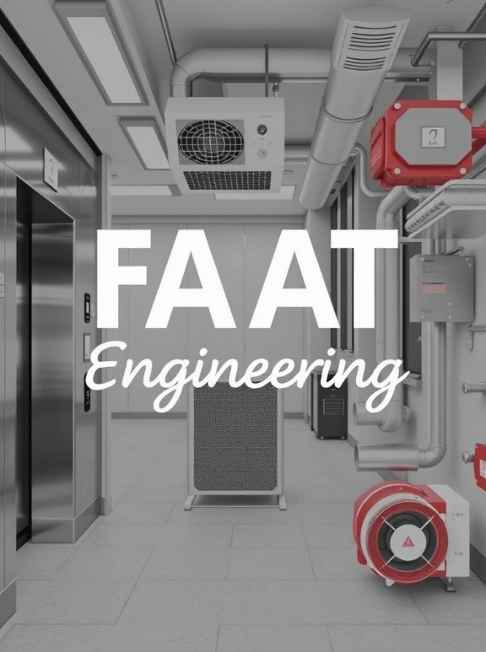
Who We Are
FAAT Engineering is a regional leader in electromechanical systems, providing integrated solutions in Elevators, HVAC, fire protection, and Smoke Management. Established in 1963, we have built a strong reputation not only for executing high-quality, cost-effective projects but also for our early-stage design involvement and unmatched after-sales support. Our partnerships with world-renowned brands like Mitsubishi, Fujitsu General, Carrier and SFFECO enable us to deliver technically sound, code-compliant systems tailored to our clients’ needs. From concept to commissioning—and well beyond—we are known for standing by our clients with technical guidance, responsive maintenance, and long-term reliability.
FAAT Engineering

Slide 4
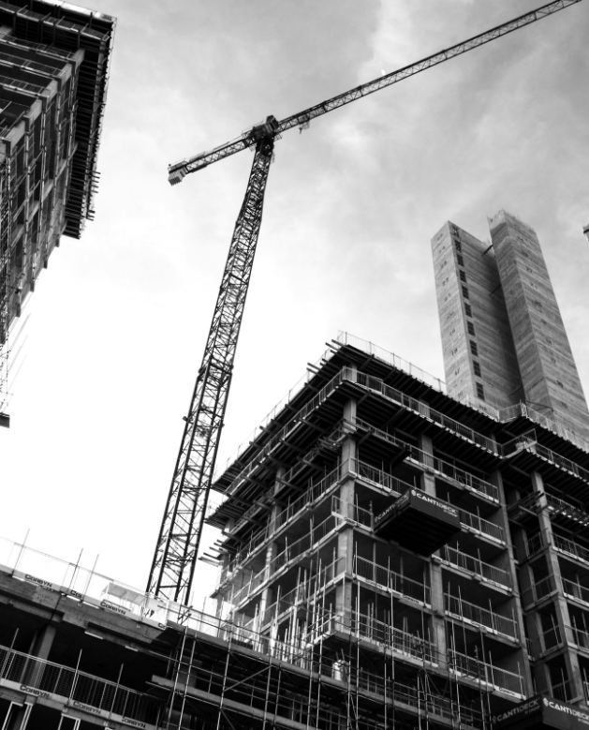
Our Mission
"At FAAT Engineering, we are committed to delivering high-quality, cost-effective electromechanical solutions by fostering a culture of innovation, integrity, and teamwork.
Through our expertise in Elevators, HVAC, fire protection, and Smoke Management, we strive to exceed customer expectations while maintaining the highest standards of safety, efficiency, and sustainability.
Our dedication to long-term partnerships, continuous improvement, and cutting-edge technology ensures that we provide reliable, future-ready solutions for commercial, industrial, and residential projects."
FAAT ENGINEERING

Slide 5
✅ Exclusive Brand Partnerships
✅ End-to-End Contracting Expertise
✅ Regulatory & Quality Compliance
✅ Sustainable & Green Engineering
✅ Technology Integration
Why Choose US?

Slide 6
Quality Health &Safety (QHSE)
FAAT Engineering integrates QHSE into every project, ensuring safety, sustainability, and top-quality solutions for our clients and communities.
1. Quality Assurance (QA)
Adherence to ISO 9001 standards
Rigorous inspection & testing
Continuous improvement & feedback
Compliance with industry regulations
2. Health & Safety (HSE)
Zero-accident goal with strict safety protocols
ISO 45001 certified Occupational Safety System
Regular safety training & risk assessments
Emergency response & preparedness plans
3. Environmental Responsibility
ISO 14001 certified for environmental management
Energy-efficient & green technologies
Waste reduction & recycling programs
Compliance with local & international laws
FAAT ENGINEERING

Slide 7
Company Divisions
Products
Engineering
After Sales
Exclusive distributor of premium Elevators, HVAC, Fire Protection, Smoke Management.
Design – Innovative designs for efficient systems.
Contracting – Precision installation, lasting performance.
Tech-driven maintenance with MEPSOL for optimized performance, and minimal downtime.
FAAT Engineering

Slide 8
Company Divisions
FAAT PRODUCTS

Slide 9
FAAT LIFTS
01
Exclusive distributor of Shanghai Mitsubishi Elevators, offering passenger, freight, and panoramic lifts.
Advanced safety and control systems compliant with EN81 standards.
Customizable cabin designs, door configurations, and modernization solutions.
What
We Offer
FAAT HVAC
02
Premium Fujitsu VRF systems, Carrier chillers, and EVAPCO cooling towers.
Energy-efficient heating and cooling solutions for commercial and industrial applications.
Comprehensive ventilation, air purification, and ducting systems for optimal indoor air quality.
FAAT FIRE
03
Fire suppression, smoke management, and alarm systems designed to meet NFPA & FM standards.
High-performance sprinklers, fire pumps, and extinguishing systems for all property types.
Reliable emergency response and fire safety solutions for maximum protection.
FAAT Engineering

Slide 10
FAAT Lifts
Who We Are
FAAT LIFTS is the vertical transportation division of FAAT Engineering, proudly representing Shanghai Mitsubishi Elevator Co., Ltd. in Syria. As the global leader in elevator and escalator technology, Shanghai Mitsubishi brings cutting-edge Japanese engineering and decades of proven performance to our market.
Through this exclusive partnership, FAAT LIFTS offers a full range of premium elevators, escalators, and moving walkways that meet the highest international standards for safety, efficiency, and innovation. Our solutions are tailored for residential towers, commercial complexes, luxury hotels, industrial facilities, and public transport hubs, ensuring smooth and reliable mobility in every application.
FAAT Engineering

Slide 11
Our Expertise
FAAT LIFTS provides comprehensive solutions for vertical transportation, including:
✅ Passenger Elevators – High-speed, energy-efficient models for offices, malls, and towers.
✅ Home Lifts – Compact, luxurious lifts designed for villas and private residences.
✅ Freight & Service Elevators – Heavy-duty solutions for warehouses, hospitals, and industrial settings.
✅ Dumbwaiters – Small-scale service lifts ideal for hotels, restaurants, and medical facilities.
✅ Panoramic Elevators – Elegant, all-glass cabin designs for high-end commercial buildings.
✅ Escalators & Moving Walks – High-performance solutions for malls, airports, and transit hubs.
✅ Custom Cabin Design – Bespoke interior finishes to match architectural aesthetics.
✅ Modernization & Upgrades – Retrofitting existing elevators with the latest safety and energy-efficient technologies.
FAAT ENGINEERING

Slide 12
FAAT HVAC
Who We Are
FAAT HVAC is a specialized division of FAAT, delivering high-performance heating, ventilation, and air conditioning (HVAC) solutions for residential, commercial, industrial, and critical infrastructure projects. With a commitment to energy efficiency, sustainability, and indoor air quality, we provide customized climate control systems that ensure optimal comfort and reliability.
As an exclusive distributor of global HVAC brands such as Fujitsu VRF, Carrier Chillers, EVAPCO Cooling Towers, Beta Smoke Management. FAAT HVAC integrates cutting-edge technology and smart building solutions to enhance operational efficiency while minimizing energy consumption.
FAAT Engineering

Slide 13
Our Expertise
FAAT HVAC specializes in turnkey solutions, including:
✅ VRF & DX Systems – High-efficiency cooling and heating with variable refrigerant flow (VRF) and direct expansion (DX) systems.
✅ Chilled Water Systems – Carrier air-cooled and water-cooled chillers for large-scale cooling applications.
✅ Packaged & Rooftop Units – Ideal for malls, commercial complexes, and industrial plants.
✅ Air Handling Units (AHUs) & Fan Coil Units (FCUs) – Ensuring optimal air circulation and climate control.
✅ Ventilation & Fresh Air Systems – High-quality exhaust, supply, and pressurization systems to maintain indoor air quality.
✅ Cooling Towers – EVAPCO cooling towers for power plants, industrial cooling, and large-scale HVAC applications.
✅ Humidity & Air Filtration Systems – Advanced humidifiers, dehumidifiers, and HEPA filtration for clean environments.
✅ Smoke Management & Pressurization – CFD-designed pressurization and extraction systems for fire safety compliance.
✅ Circulation Pumps – Armstrong circulation pumps for HVAC systems, heating loops, and industrial applications.
FAAT ENGINEERING

Slide 14
FAAT FIRE
Who We Are
FAAT FIRE is a specialized division of FAAT, providing comprehensive fire protection, detection, and suppression solutions for commercial, industrial, residential, and critical infrastructure projects. With a commitment to life safety, compliance, and innovation, FAAT FIRE ensures that buildings and facilities are fully protected against fire hazards, adhering to NFPA, EN, UL, FM, and local fire safety codes.
As an authorized distributor of SFFECO Fire Systems, FAAT FIRE delivers state-of-the-art fire detection, suppression, and emergency response systems to safeguard people, assets, and critical infrastructure.
FAAT Engineering

Slide 15
Our Expertise
FAAT FIRE provides turnkey fire safety solutions, including:
✅ Fire Alarm & Detection Systems – Addressable and conventional fire alarm systems with smoke, heat, and gas detectors.
✅ Sprinkler Systems – Automatic wet, dry, deluge, and pre-action sprinkler systems.
✅ Fire Suppression Systems – FM200, CO2, Foam, Dry Chemical, and Water Mist suppression systems.
✅ Fire Pumps & Hydrant Systems – SFFECO UL/FM-approved fire pumps and fire hydrant networks.
✅ Emergency & Exit Lighting – Illuminated exit signs and backup lighting for emergency egress.
✅ Kitchen Hood Fire Suppression Systems – Specialized restaurant & commercial kitchen fire protection solutions.
✅ Smoke Management Systems – Pressurization systems, smoke extraction, and CFD-based design for evacuation safety.
✅ Gas-Based Suppression – Clean agent fire suppression for server rooms, data centers, and archives.
✅ Fire Doors & Passive Protection – Certified fire-rated doors, dampers, and compartmentalization solutions.
FAAT ENGINEERING

Slide 16
Company Divisions
Engineering

Slide 17
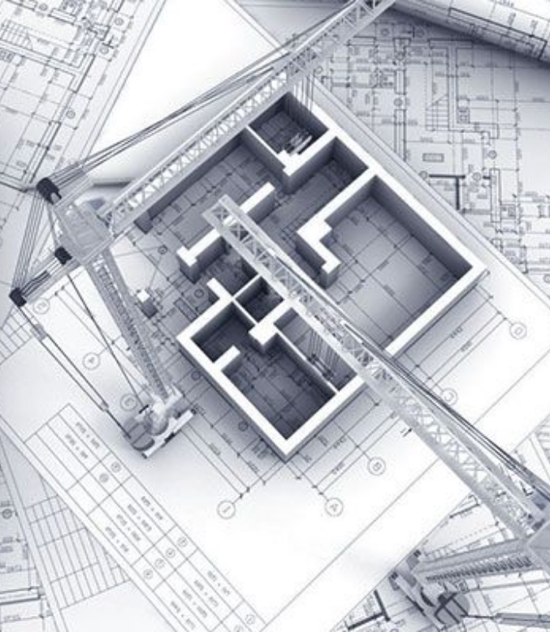
FAAT Engineering
FAAT Engineering provides engineering design solutions in HVAC, fire protection, energy optimization, and vertical transportation systems. We collaborate closely with leading MEP design companies, offering expert support in mechanical design, project management, and strategic planning to ensure exceptional project outcomes and regulatory compliance.
✅ HVAC Systems – Design, installation, and commissioning.
✅ Plumbing & Drainage – Water supply, drainage networks, and sanitation systems.
✅ Fire Protection Systems – Fire alarms, suppression, and hydrant systems.
✅ Smoke Management & Pressurization – CFD-based smoke control solutions.
✅ Vertical Transportation – Installation of elevators, escalators, and moving walkways.
FAAT Engineering

Slide 18
Engineering & Design
✅ Value Engineering
Smart, cost-effective solutions that maintain quality and performance. We optimize materials, system designs, and energy efficiency while exploring alternative technologies to reduce costs and enhance sustainability.
✅ HVAC System Design
Comprehensive load calculations, ventilation planning, and energy modeling ensure optimal performance. We specialize in equipment selection, scheduling, and CFD simulations for airflow and smoke movement analysis.
✅ Electrical System Design
From power distribution layouts to backup power integration, we design efficient electrical systems. Our expertise includes smart automation, lighting control for energy savings, and low-voltage security system integration.
✅ Power Auditing & Energy Optimization
We analyse energy consumption patterns to identify inefficiencies and reduce costs. Our services include load profiling, power factor correction, and renewable energy integration to enhance sustainability and optimize performance.
FAAT Engineering

Slide 19
Engineering & Design
✅ Plumbing & Water System Design
We provide expert planning for sanitary drainage, stormwater management, and medical gas systems. Our solutions include water treatment and supply network design to ensure efficiency and reliability.
✅ Fire Protection & Smoke Control Design
Our fire safety solutions include sprinkler system design, hydraulic studies, and fire alarm and suppression planning. We use CFD-based smoke control strategies for high-rise and industrial projects to enhance safety and compliance.
✅ Vertical Transportation Design
We specialize in the planning and specification of passenger & freight elevators, escalators, and moving walkways for commercial and public spaces. Our modernization strategies improve efficiency, safety, and code compliance.
FAAT Engineering

Slide 20
Contracting
✅ HVAC Contracting
Chillers, VRF, DX, split systems & air handling units.
Ducting, ventilation, and pressurization systems.
Building Management System (BMS) integration.
✅ Plumbing & Drainage Contracting
Sanitary systems & water supply networks.
Stormwater & greywater recycling.
Medical gas systems for healthcare applications.
✅ Fire Protection & Smoke Management Installation
Fire alarms, suppression, and sprinkler systems.
Pressurization & smoke extraction systems (CFD-based design).
Passive fire protection & compartmentalization.
✅ Vertical Transportation Installation
Installation of passenger, freight, panoramic elevators.
Escalators & moving walkways for malls, airports, and transit hubs.
Modernization & upgrade solutions for aging systems.
FAAT Engineering

Slide 21
Project Execution Process
1. Planning & Design
In-depth feasibility studies & load calculations.
3D modelling & BIM integration.
Compliance with international & local codes.
Genworkshop, coordination, and as-built drawings.
3. Installation & Execution:
Highly trained technicians & project managers ensure precision.
Efficient site coordination to maintain timelines & quality.
Real-time tracking through advanced project management tools.
2. Procurement & Material Management:
Sourcing from approved vendors & global suppliers.
Strict quality control & logistics management.
Compliance with sustainability & green building practices.
4. Testing, Commissioning & Handover:
Detailed system testing & calibration.
Client training for effective system operation.
Post-installation support & maintenance options.
FAAT Engineering

Slide 22
Competitive Advantage
✅ Comprehensive Expertise – Covering HVAC, Electrical, Plumbing, Fire, Smoke Management, and Vertical Transportation under one roof, ensuring seamless project execution.
✅ End-to-End Project Management – From concept design to installation and lifecycle maintenance, reducing risks and ensuring efficiency.
✅ Regulatory & Safety Compliance – Strict adherence to NFPA, EN, ASHRAE, ISO, and local regulations, ensuring safety and quality across all projects.
response.
FAAT Engineering is a market leader in electromechanical contracting, offering distinct advantages that set us apart:
✅ Innovative Engineering Solutions – Advanced BIM modelling, CFD analysis, and BMS integration for energy-efficient, future-ready systems.
✅ Proven Track Record of Excellence – Successfully delivering complex electromechanical solutions across commercial, industrial, and public sectors.
✅ Sustainability & Smart Building Integration – Energy-efficient solutions that enhance building performance while reducing carbon footprint.
FAAT Engineering

Slide 23
Company Divisions
After Sales

Slide 24
Comprehensive MEP Maintenance
01
Full-service maintenance for Elevators, HVAC, Fire protection, Electrical, and Plumbing systems.
Preventive & corrective maintenance.
Compliance with industry standards (EN81, NFPA, ISO).
What
We Offer
MEPSOL-Powered Smart Maintenance
02
Data-driven predictive maintenance to minimize failures.
Real-time monitoring & diagnostics for faster issue resolution.
Digital work order management, tracking, and automated reporting for compliance.
Facility & Asset Management Solutions
03
Tailored maintenance plans for commercial, residential, and industrial properties.
Inventory & spare parts management to reduce downtime.
24/7 emergency response and remote support for critical systems.
FAAT Engineering

Slide 25
Our Expertise
Expertise in maintaining complex systems like Elevators, HVAC, Fire Systems, Boilers, and Generators.
FAAT Engineering

Slide 26
MEPSOL Integration
Experience seamless management of maintenance schedules, tasks, and tickets with MEPSOL.
FAAT Engineering

Slide 27
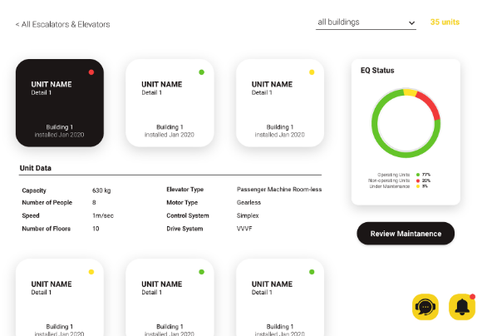
Centralizing Maintenance Management
MEPSOL is a maintenance management platform developed by FAAT Engineering that allows clients to monitor the status, repair history of their units, and access billing information.
FAAT Engineering

Slide 28
Services Overview
FAAT Engineering

Slide 29
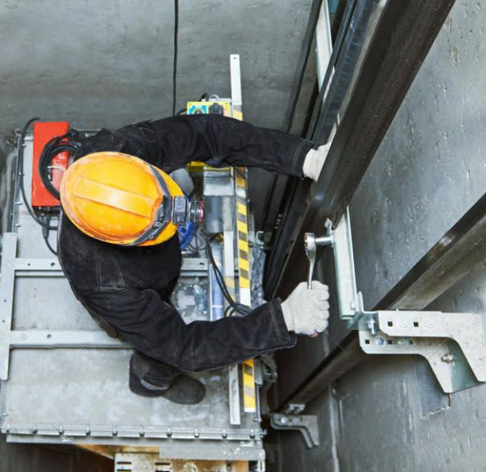
Elevator Maintenance
Reliable Elevator Maintenance
Preventive and corrective maintenance.
Compliance with EN 81 safety standards.
Remote monitoring and diagnostics with MEPSOL.
24/7 emergency repair services.
Modernization and retrofitting solutions.
FAAT Engineering

Slide 30
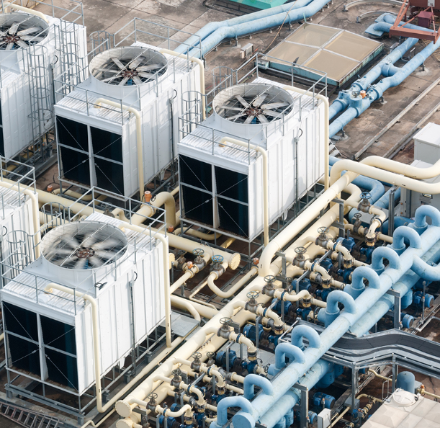
HVAC Maintenance
Energy-Efficient HVAC Maintenance
Routine checks for chillers, AHUs, and duct systems.
Seasonal start-up and shutdown support.
Energy efficiency optimization.
IoT-enabled real-time monitoring for early issue detection.
FAAT Engineering

Slide 31
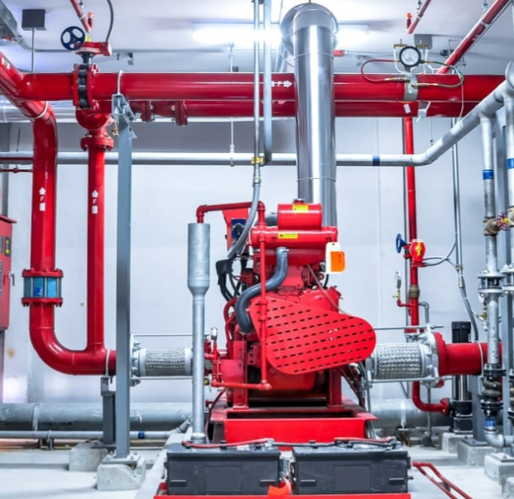
Fire Systems Maintenance
Regular inspection and testing of alarms, sprinklers, and hydrants.
NFPA compliance assurance.
Emergency response training and support.
Comprehensive fire panel diagnostics and repairs.
FAAT Engineering

Slide 32
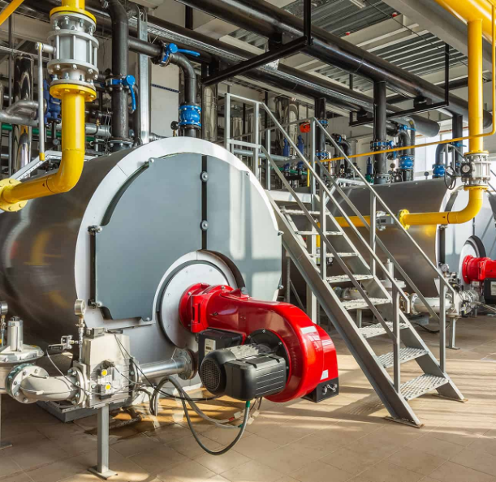
Mechanical Systems Maintenance
Boilers: Burner cleaning, safety checks, and water treatment.
Generators: Load testing, fuel checks, and cooling maintenance.
Real-time monitoring with MEPSOL for faster response.
FAAT Engineering

Slide 33
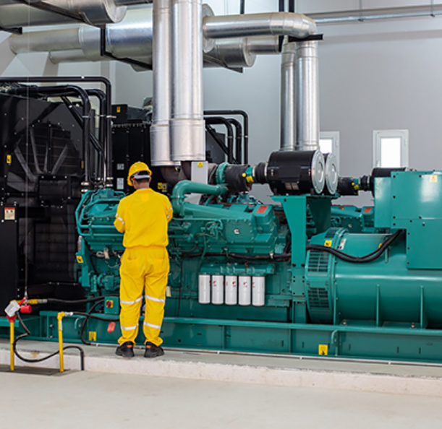
Electrical Systems Maintenance
Backup power system inspections (UPS, generators).
Load balancing and power quality analysis.
Lightning protection system inspections.
Regular lighting system checks and replacements.
FAAT Engineering

Slide 34
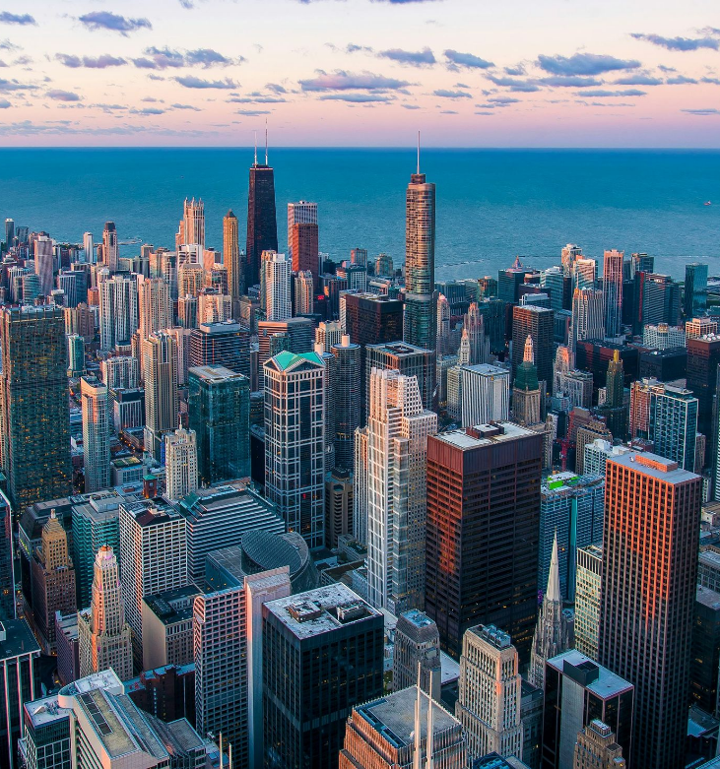
Key Projects & Clients
Key Projects
FAAT Engineering

Slide 35
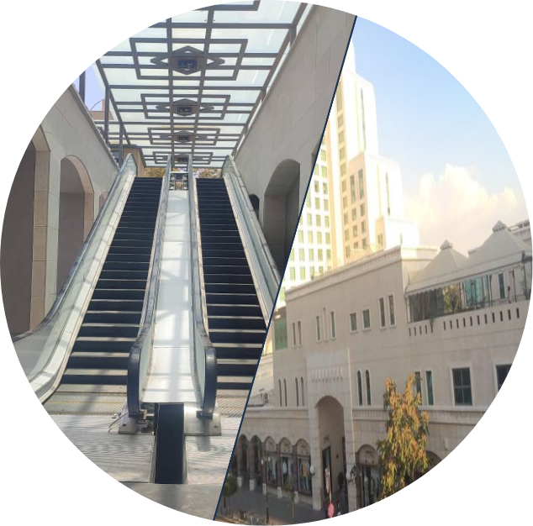
Key Projects
بولفارد- دمشق
Boulevard - Damascus
The Damascus Boulevard project is a luxury commercial complex, designed with modern aesthetics and engineering excellence. featuring high-end retail spaces,
6 Sharp Elevators
4 Sharp Escalators
FAAT Engineering

Slide 36
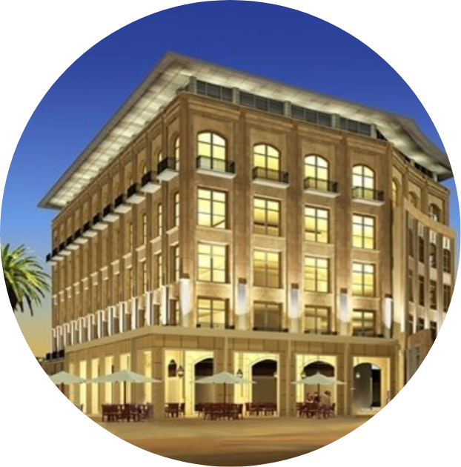
Key Projects
البوابة الثامنة- يعفور
The Eighth Gate - Yaafour
The Eighth Gate project is a landmark commercial development blending unique style, innovative design, and architectural excellence, strategically located 15 km from central Damascus and spanning over 400,000 square meters, setting a new standard for business and luxury in the region.
30 Mitsubishi Elevators.
FAAT Engineering

Slide 37
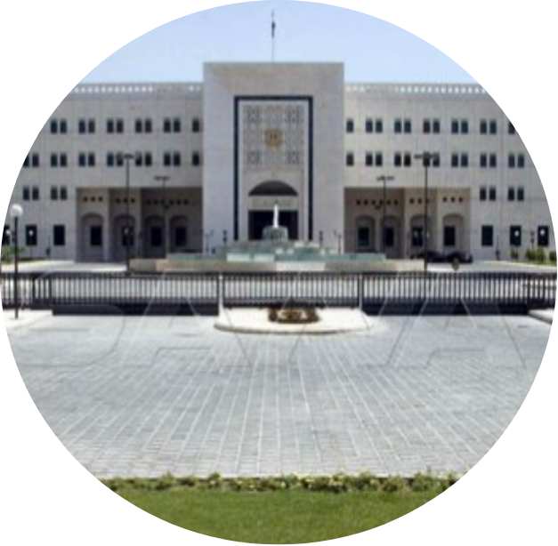
Key Projects
The Prime and the Foreign Ministry Buildings
مباني مجلس االوزراء و الخارجية
The chief executive body of the Syrian Arab Republic, located in the capital city of Damascus. The building showcase the country's engineering prowess and commitment to providing safe and functional workspaces for its officials.
22 Mitsubishi Elevators
FAAT Engineering

Slide 38
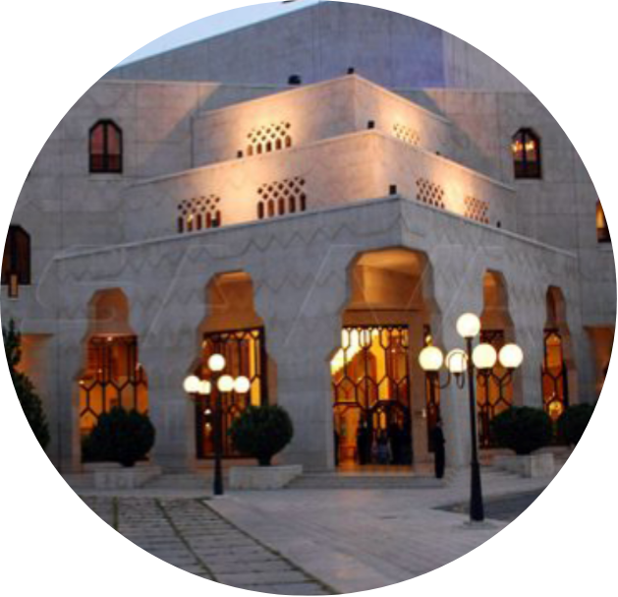
Key Projects
The Opera House-Damascus
دار الأوبرا - دمشق
The Opera House-Damascus is a historic cultural institution located in Damascus, Syria. A five-level building that includes a 1300-seat theatre for musical productions, a drama theatre of some 600 seats and a small multipurpose hall.
2 Carrier Chillers
FAAT Engineering

Slide 39
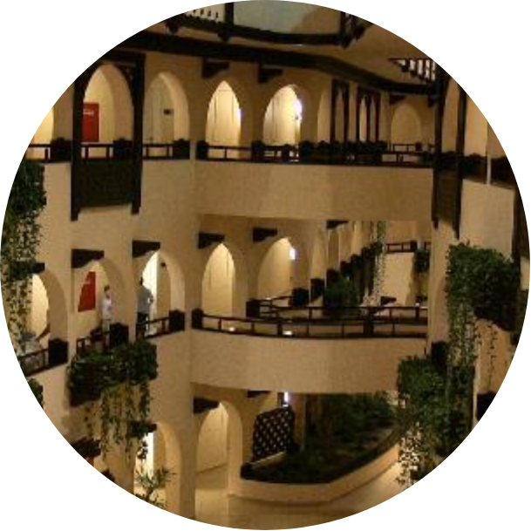
Key Projects
فندق روتانا افاميا - اللاذقية
Rotana Afamia Resort-Lattakia
Rotana Afamia is a well-engineered property that balances luxury and comfort with modern engineering principles. Designed with sustainability in mind, it incorporates energy-efficient features for long-term efficiency and functionality.
8 Mitsubishi Elevators.
FAAT Engineering

Slide 40
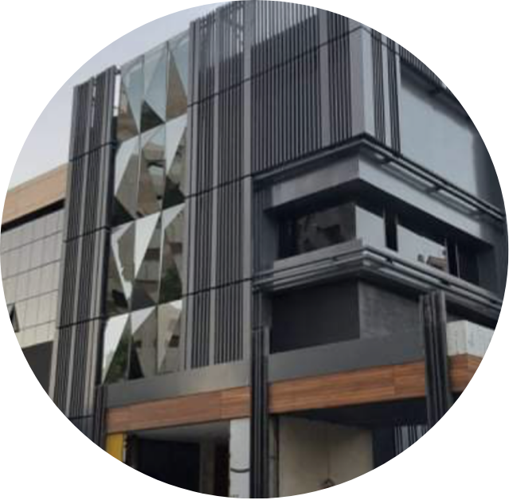
Key Projects
مول آفنيو المالكي - دمشق
Malki Avenue Mall – Damascus
Malki Avenue Mall is one of the most popular and high-end malls in Damascus, known for its premium retail offerings and upscale ambiance. .
3 Mitsubishi Elevators.
8 Mitsubishi Escalators
FAAT Engineering

Slide 41
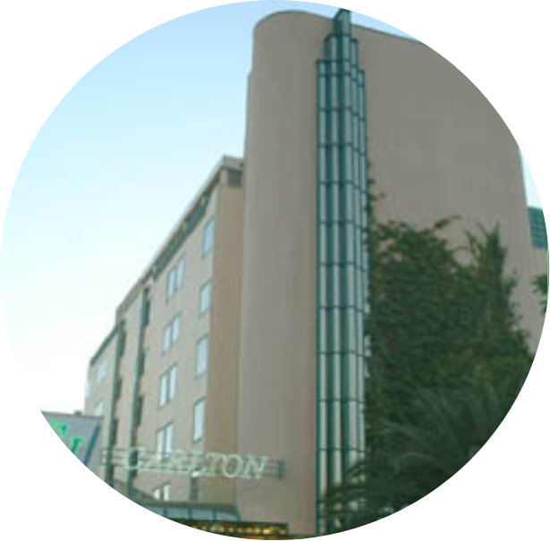
Key Projects
The Carlton Hotel- Damascus
فندق الكارلتون - دمشق
The Carleton Hotel in Damascus is a renowned luxury hotel known for its elegant architecture, exceptional hospitality, and prime location in the heart of the city.
2 Carrier Chillers
FAAT Engineering

Slide 42
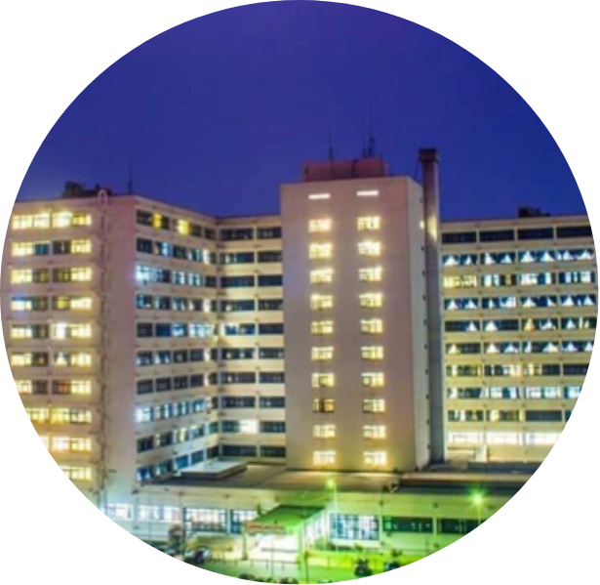
Key Projects
Tishreen University Hospital-Lattakia
مشفى جامعة تشرين - اللاذقية
Being the largest health centre in the Syrian coast, a leading medical facility that provides a wide range of healthcare services to patients.
10 Carrier Chillers
FAAT Engineering

Slide 43
Key Projects
United Insurance Company المتحدة للتأمين
The United Insurance Company (UIC) inaugurated its new headquarters in Damascus in 2024, a modern facility designed to reflect its commitment to innovation and excellence.
1 Sharp Car Elevator
2 Sharp Panoramic Elevators
FAAT Engineering

Slide 44
Key Oil Fields Projects
Al Tanak oil field-Deir Al Zor
حقل التنك - دير الزور
Al Jafra oil field-Deir Al Zor
حقل الجفرة - دير الزور
2 Carrier Chillers
2 Carrier Chillers
Al Omar oil field-Deir Al Zor
حقل العمر - دير الزور
2 Carrier Chillers
8 Carrier Packages
FAAT Engineering

Slide 45
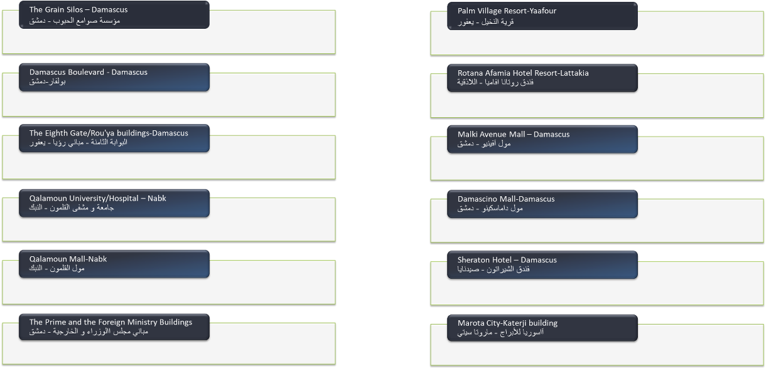
Projects List
FAAT Engineering

Slide 46
Projects List
FAAT Engineering

Slide 47
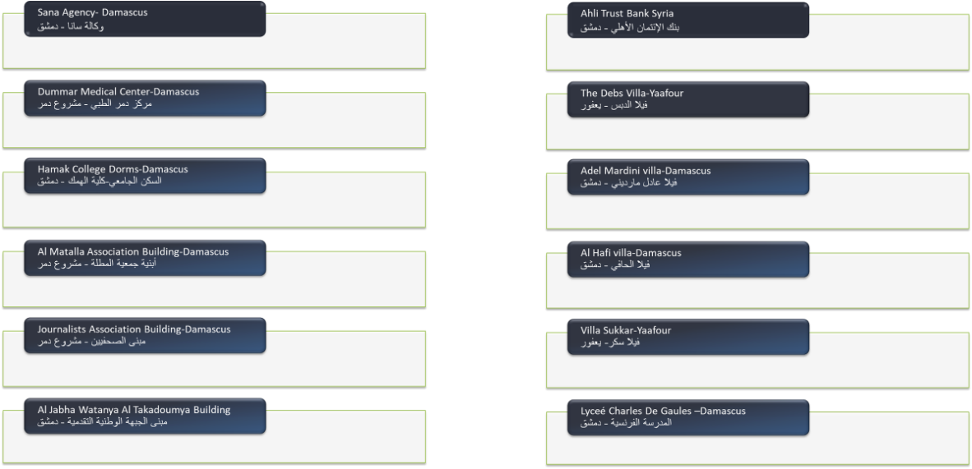
Projects List
FAAT Engineering

Slide 48
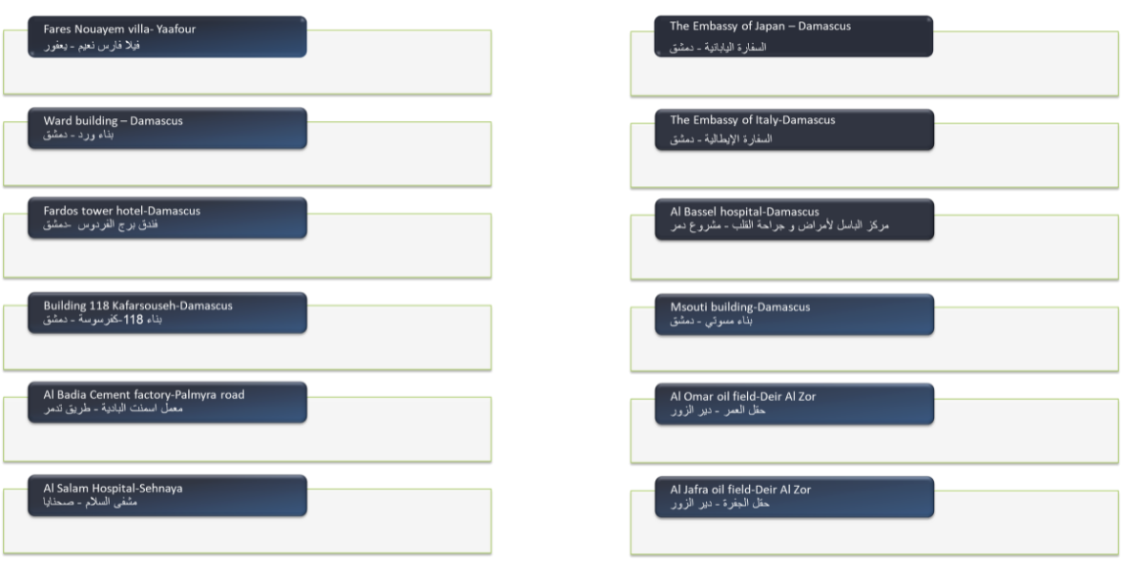
Projects List
FAAT Engineering

Slide 49
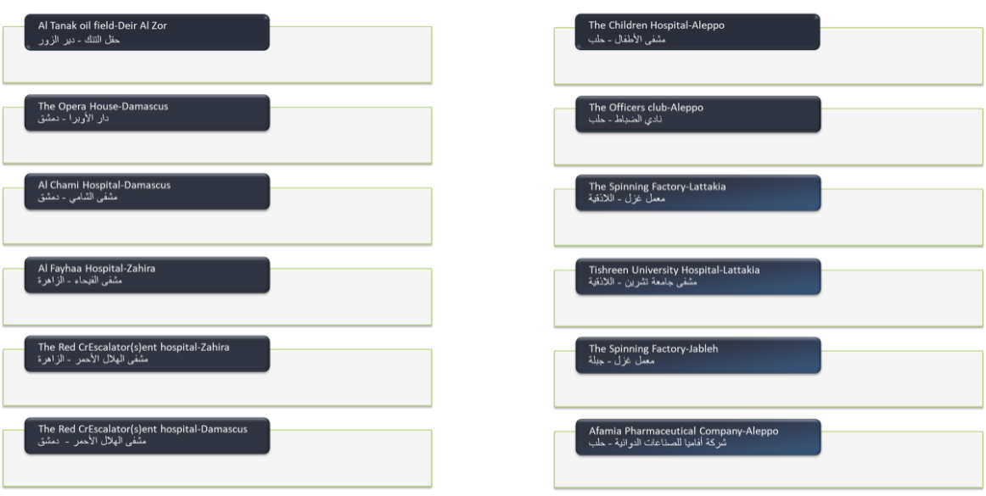
Projects List
FAAT Engineering

Slide 50
Projects List
FAAT Engineering

Slide 51
Projects List
FAAT Engineering

